Slide 1
Report from the 71st Meeting
of the DESY PRC
April 28-29, 2011
Andy White, University of Texas at Arlington – for the DESY PRC
DESY Scientific Council Meeting, May 16-17, 2011

Slide 2
Research areas reviewed
 Detector R&D
- CALICE
 Future HEP Experiments
- OLYMPUS
- ALPS
LHC Experiments
- ATLAS
- CMS
- Computing
HERA Experiments
- ZEUS
- H1
- ZEUS/H1 Combined
- HERMES
- POL2000
Astroparticle
- CTA
- Ice-Cube
 Theory

Slide 3
CALICE
* The PRC reviews ALL CALICE activities – not just the DESY-specific items
Comprehensive report requested and received
CALICE ~350 people/57 groups/17 countries/4 continents
 Various projects aimed towards aspects of highly segmented calorimetry for a future Linear Collider detector, motivated by Particle Flow for jet reconstruction.
 Given focus by common test beams, combining ECAL/HCAL/tail catcher (TCMT); common DAQ/analysis.
 First round –small “physics prototypes”
Evaluate technologies; identify problem areas.-
Validate Monte Carlo simulations, especially for hadronic showers, so that results can feed into full detector simulations.
Still sizeable systems with ~20K channels.
 Second phase –“technological prototypes”(mainly under aegis of EUDET).

Slide 4
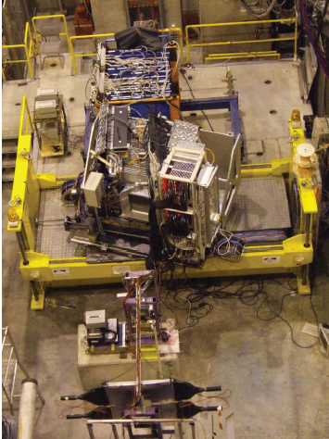
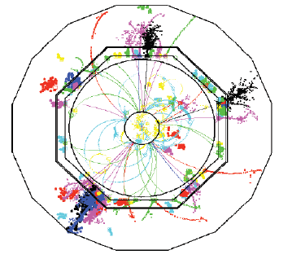
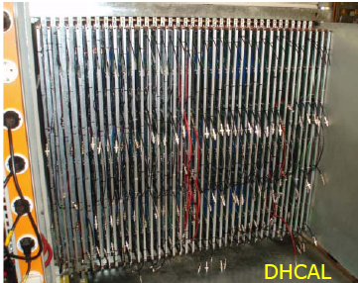
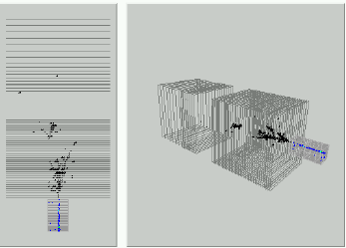

Slide 5
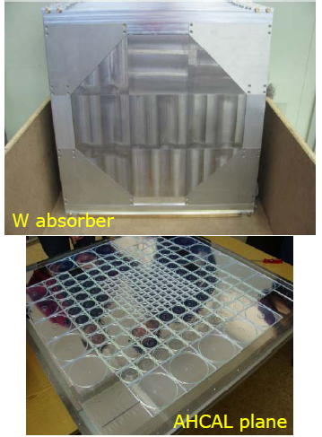
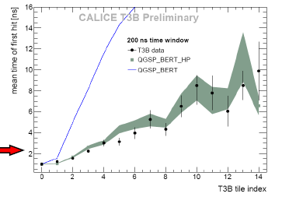
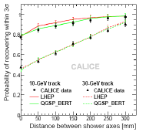
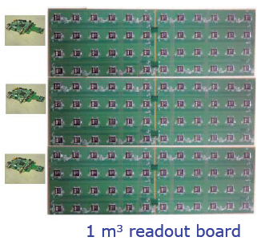
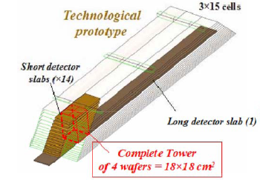
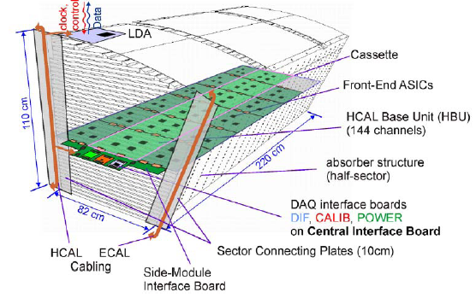
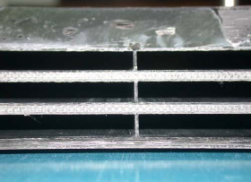

Slide 6
Recommendations - CALICE
The PRC congratulates the CALICE collaboration for the successful development of future PFA (particle flow algorithm) calorimeters with a wide variety of options in an extensive way.
The PRC also congratulates the collaboration on its effective test beam campaigns at CERN and Fermilab. The further efforts with the test beam to improve prototypes as realistic components of future ILC detectors to be presented in the ILC DBDs in 2012 are highly supported.
The PRC notes the challenges associated with the provision of adequate test beam time. The PRC recommends that DESY continues support for necessary modifications to test beam fixtures, test beam campaigns at CERN and Fermilab, continuation of electronics integration development, mechanical and electrical engineering, and provision of computing resources.

Slide 7

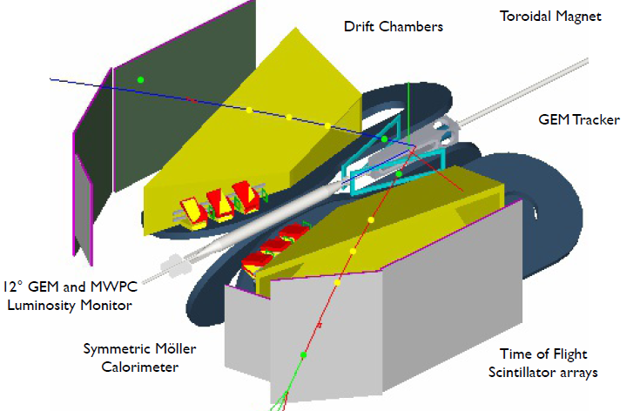
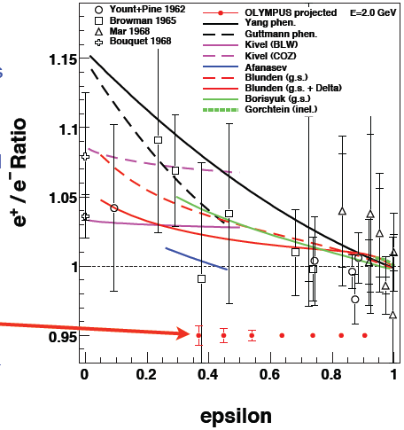
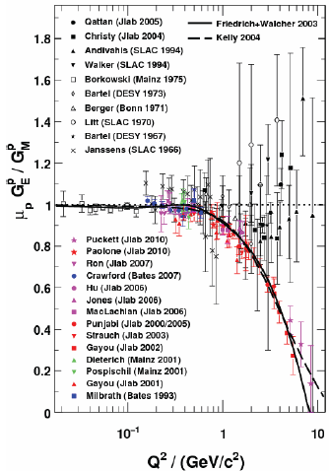
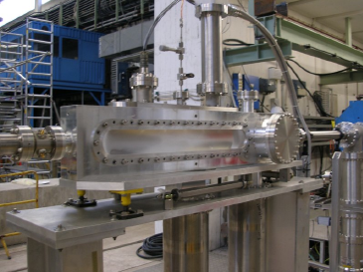
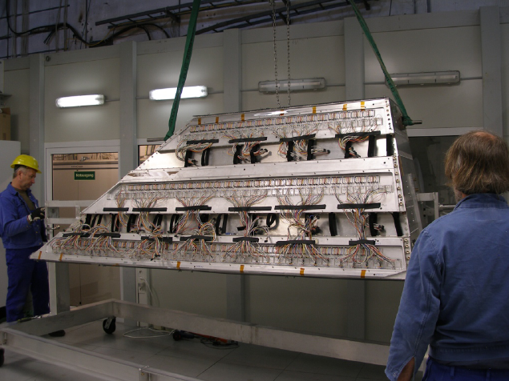
OLYMPUS
Target chamber
Drift Chamber

Slide 8
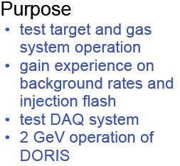
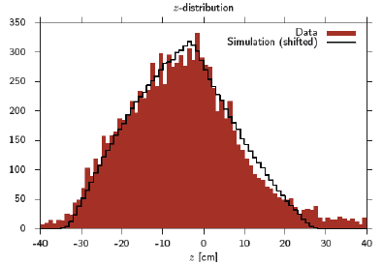

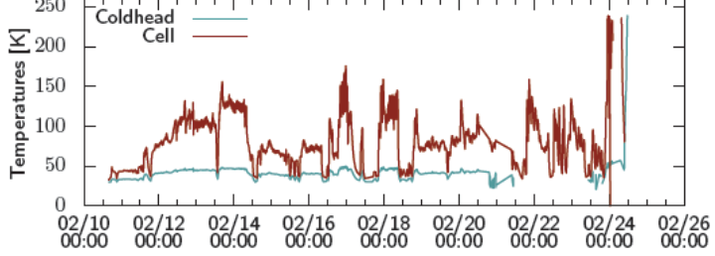
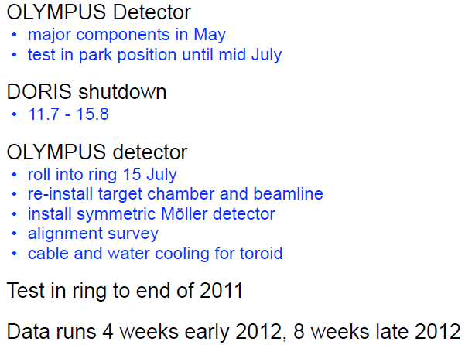
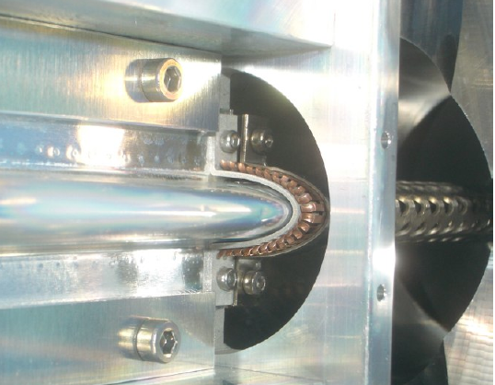
OLYMPUS

Slide 9
Recommendations- OLYMPUS
The PRC congratulates the collaboration for great progress since the last meeting.
The DORIS test run was very successful…but it also revealed a problem with heating of the target cell. The RF shielding design of the target cell as well as the cooling of the target cell was changed. The target cell should be as soon as possible best in the DORIS shutdown end of May reinstalled to DORIS and tested again. If this is not possible RF tests of the cell on a test bench should be performed and the target chamber/cell should be reinstalled with the rest of the detector mid of July.
At the next PRC a report on the May test beam results as well on the new beam tests of the target cell should be given. There should be also a summary on the status of the offline analysis software.
The PRC recommends that DESY makes any effort to avoid any delay of the 2nd running period end of 2012 due to delays in the PETRA shutdown. Further we recommend continual supports from the lab, since it is really critical for the success of the experiment.

Slide 10
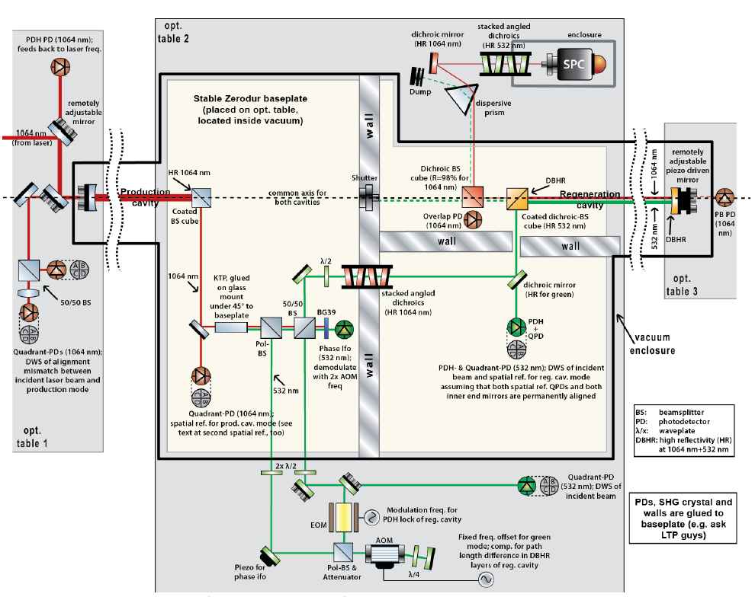
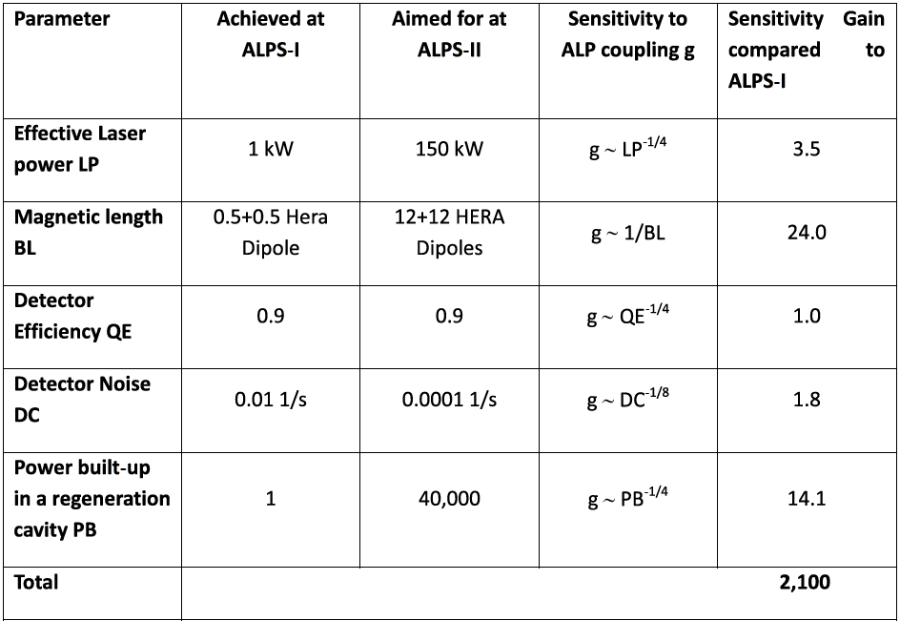
ALPS-II
Physics: Hidden photons – kinetic mixing – needs no B field.
: WISPS – coherent mixing with photons in magnetized background.
Three steps:
Set up all components except magnets in new laser lab and test. Search for hidden photons with ~10m vacuum sections: 2012.
Move to HERA tunnel and search for hidden photons with ~100m sections: 2014
In 2016 install first HERA dipoles…first data taking 2017.

Slide 11
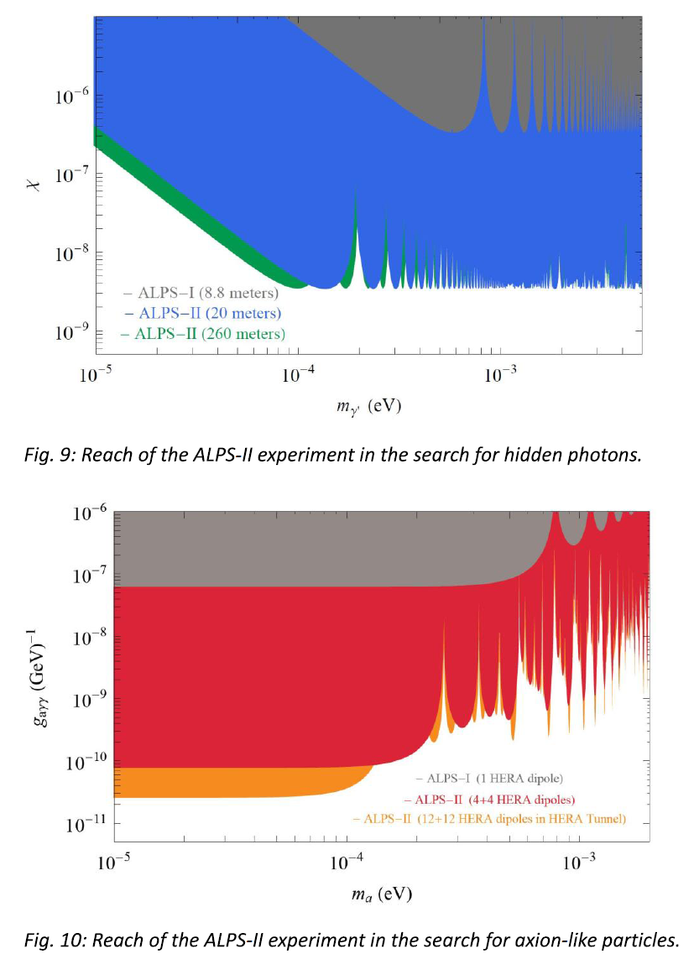
ALPS-II

Slide 12
Recommendations - ALPS
The PRC appreciates the already very impressive efforts of the newly formed ALPS II collaboration particularly recognizes the very fruitful and beneficial collaboration between the theoretical and experimental particle physics communities and the laser physicists from the gravitational wave detector community...
The PRC is willing to consider the possibility of a future ALPS II experiment at DESY and invites the ALPS collaboration to proceed towards a full technical design report.
- The proposed multi-step procedure towards the full experiment, with the possibility to achieve new physics results on the way, is very much appreciated and DESY should provide the necessary support to the ALPS II collaboration to perform the preparatory steps.
- Before being able to make a definitive statement on the full experiment it important to carefully evaluate the "physics case", including competing projects on the timescale 2013 - 2016. Ideally, this would happen in the form of a workshop once a draft version of the TDR is available.

Slide 13
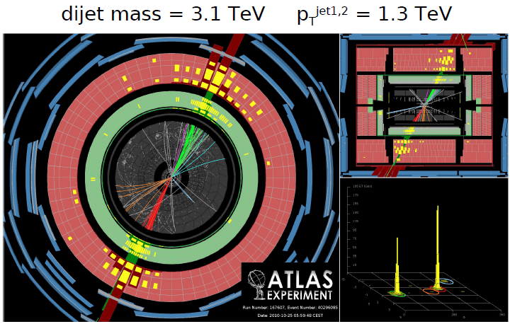
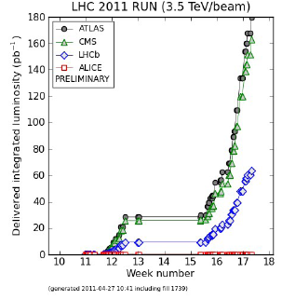
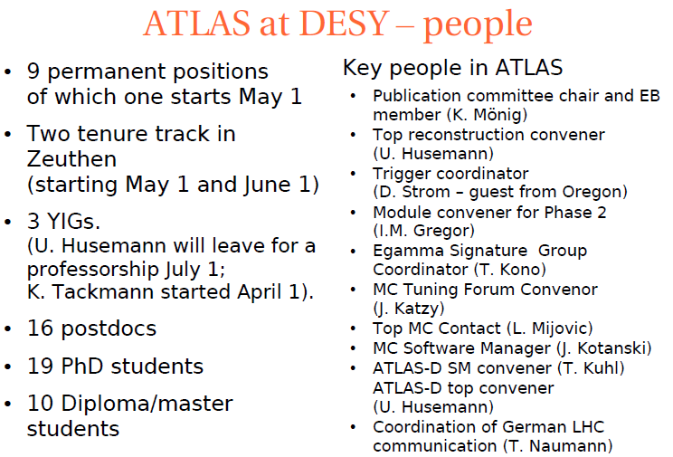
ATLAS
LHC Performance

Slide 14
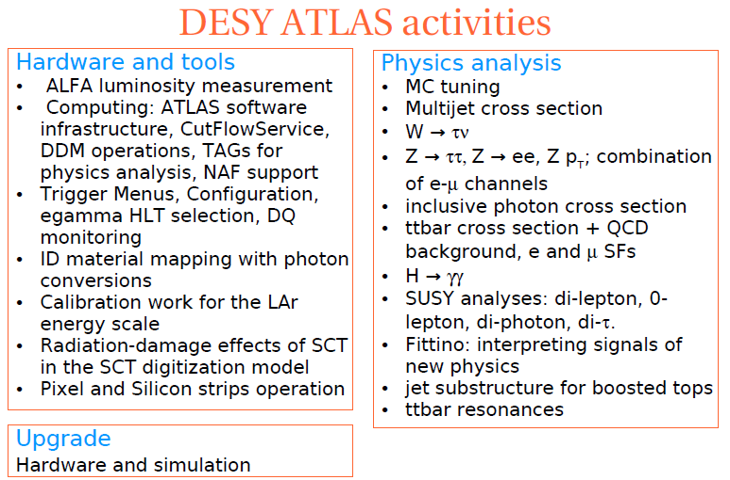
ATLAS

Slide 15

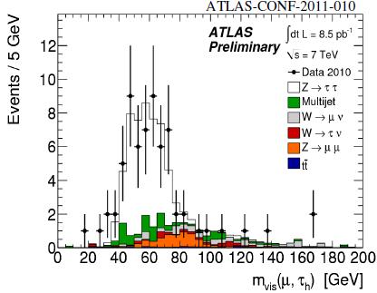
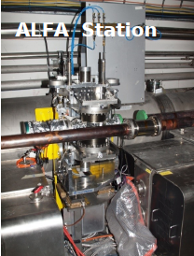
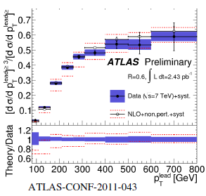

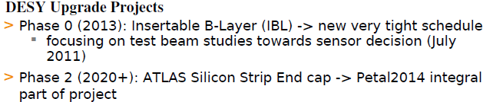
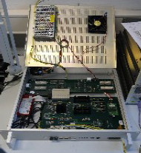
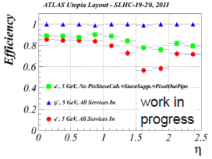

ATLAS
Module assembly/testing in Zeuthen

Slide 16
Recommendations - ATLAS
PRC…congratulates the Atlas group for their very visible contributions to physics analyses.
PRC…notes with pleasure the increased manpower on the tracker upgrade
PRC…recommends that the group maintain a manpower level that is appropriate to the size of the (tracker) project, so that they play a major role in the tracker upgrade.

Slide 17

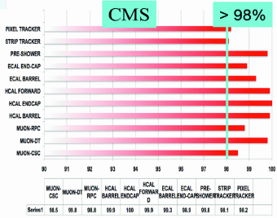
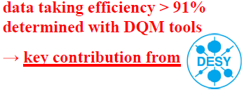
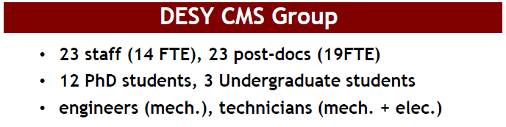

CMS

Slide 18
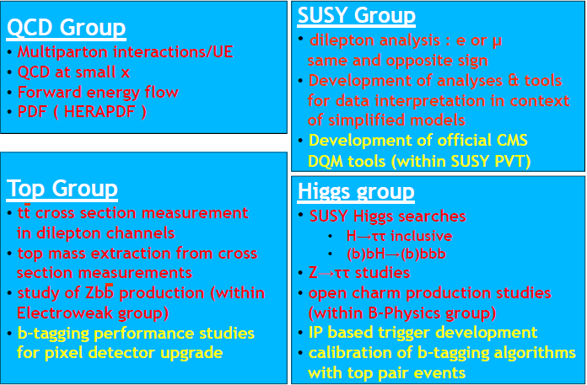
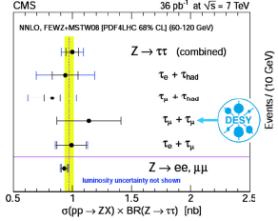
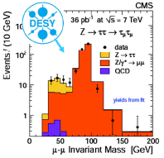

CMS
Example

Slide 19
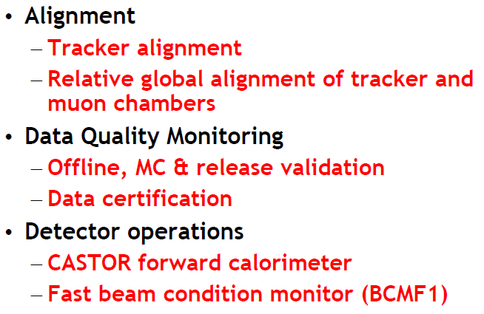



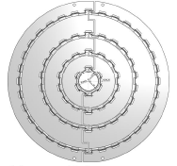
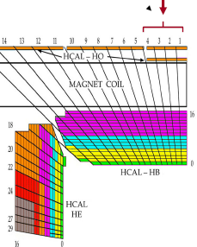
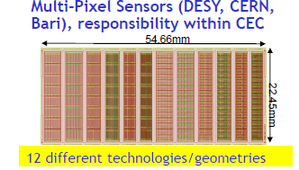

CMS

Slide 20
Recommendations - CMS
The PRC congratulates the DESY CMS group on their many strong contributions to the CMS experiment on detector operations, computing and upgrades. The group continues to play prominent roles in tracking alignment, data quality monitoring, operation of CASTOR and BCMF1, as well as in many management areas.
The organization for physics analyses has been strengthened, and that the group is beginning to make strong impacts in several analysis areas. Contributions to published and upcoming papers are beginning to appear and the PRC looks forward to further expansion of DESY contributions.
CASTOR detector should have its main pp data taking in the low luminosity regime which is coming rapidly to an end. The PRC requests a report next time on its current operation, physics output, potential physics output, and planning for future operations.

Slide 21
Computing
DESY has set up a high-performance Grid infrastructure for High Energy Physics (Tier2), which is very visible internationally. It supports the experiments ATLAS, CMS and LHCb within the LHC World-Wide computing Grid (WLCG).
The DESY Grid Centre also provides infrastructure for the HERA experiments and the ILC. DESY has also established a National Analysis Facility (NAF) for end-user analyses, which is well-accepted by the German user community.
Recently, DESY became involved in a new project, LHCone, aimed at improved network connection among the LHC Tier1 and Tier2 centres. The PRC welcomes the leading role, within Germany, of DESY in the LHCone project.

Slide 22
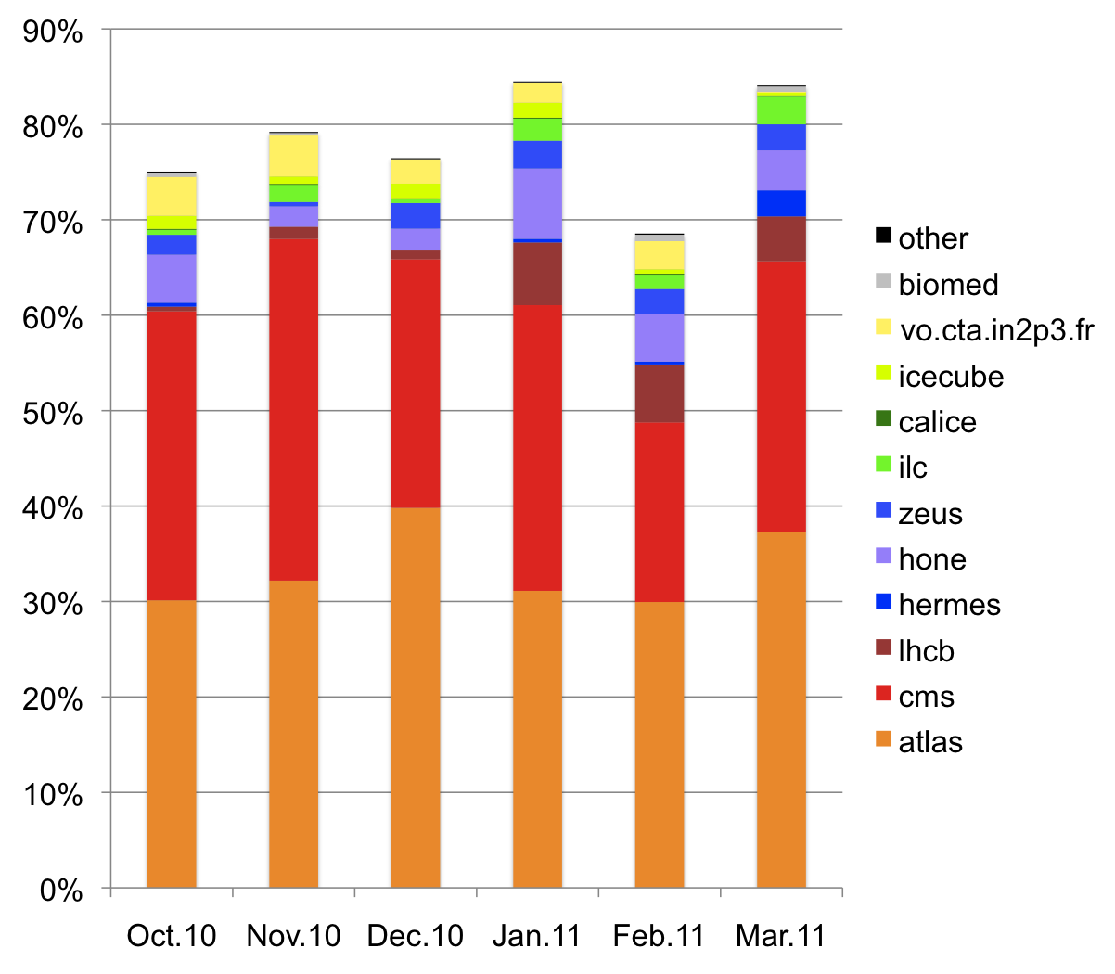
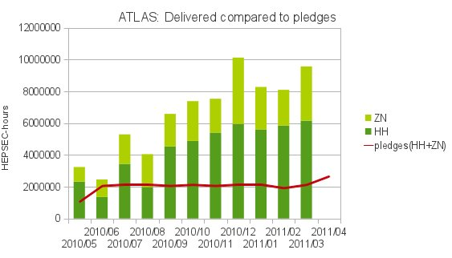
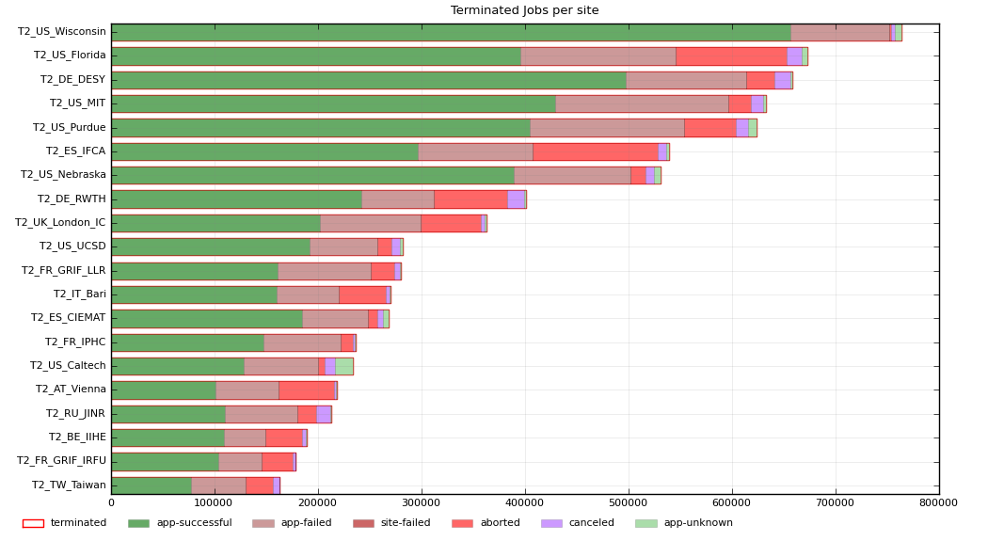
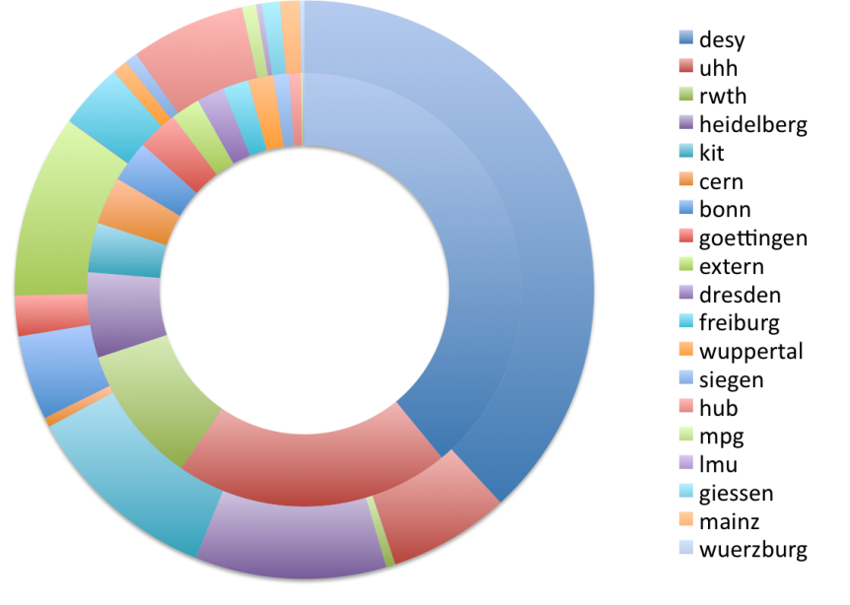
DESY-Grid Centre/NAF – supporting many activities
NAF

Slide 23
Recommendations - Computing
The PRC is concerned about future development of NAF. The PRC awaits the detailed report by the task force specifying required services and resource planning for the coming years.
For the years 2011 and 2012, there is still a substantial contribution of German universities to the LHC Tier2 computing, and the DESY share is well defined. The PRC appreciates the efficient and successful operation of the DESY Tier2 and recommends the timely installation of the DESY share of Tier2 resources in 2011 and 2012.
The PRC also encourages that DESY take an active role in finding ways to provide the necessary Tier2 resources to the German LHC community beyond 2012.

Slide 24
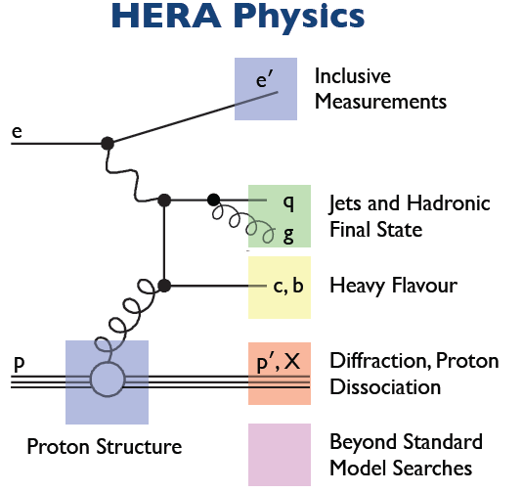
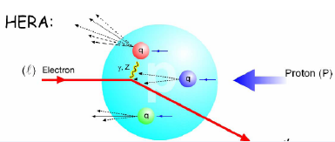

HERA Experiments
“young and immersed in work”
ZEUS
Many ( >50) young people involved in ZEUS analysis

Slide 25







ZEUS
Extension to high x and Q² – PDF constraints

Slide 26
Recommendations - ZEUS
ZEUS analysis is progressing well according to planning presented to the PRC previously. The PRC is pleased to see that the transition to the common data format is now progressing well thanks to a common effort by the collaboration and the DESY management.
The PRC welcomes the initiative of ZEUS to define the future structure of the collaboration in order to be able to provide supervisors for students to scrutinize and approve ZEUS publications beyond 2014. A report is expected for the next PRC.
- The PRC thanks the laboratory for its high level of support, and recommends that it maintain its level of support to secure successful completion of the physics program. Support for the data preservation task is recommended beyond 2014.

Slide 27





H1

Slide 28
Recommendations – H1
The PRC congratulates H1 on their dedication to the physics analysis, which resulted in many new preliminary results and five publications in 2010.
The convergence of the ongoing analyses should be closely monitored in order to ensure their publication within the next two years.
It is vital that the financial support for eastern collaborators and the technical support from IT is adequately continued…
The combined analysis with ZEUS should get high priority
The data preservation project as an international effort is now led by the DESY groups. An effort should be made to try to keep the lead and benefit from it.

Slide 29





H1/ZEUS Combined

Slide 30
Recommendations – H1/ZEUS Combined
The PRC congratulates the HERA collaborations on their impressive achievements in combining the results of the H1 and ZEUS collaborations.
Combination of HERA results is vital to secure the HERA legacy.
The importance of the combined results for the physics at the LHC and for cosmic ray physics should be more stressed.
The work on the HERAPDFs should involve also the DESY theory group.
A long term strategy for the future of the PDF effort should be worked out by the DESY management and the collaborations involved.

Slide 31





HERMES

Slide 32
Recommendations - HERMES
The HERMES collaboration continues to produce new results with high impact.
The Collaboration is especially congratulated for showing the first results for DVCS with the HERMES recoil detector.
For the next PRC the collaboration should show a plan of how to bring the data analysis to conclusion and how the structure of the collaboration is planned to be after 2012.
We recommend that DESY continues the highly appreciated support of the collaboration to extend the term for Postdocs and PhD students.

Slide 33
POL2000
Recommendations
The PRC acknowledges the efforts of the constantly decreasing polarisation group to finalize the analysis. Final results with reliable systematic errors should be given to the HERA collaborations as soon as possible.

Slide 34
Astroparticle Physics – ICE CUBE
- Ice Cube was completed on 18.12.2010
- At present data are taken with the 79-string configuration, the full 86-string detector DAQ is in the commissioning phase and will fully start within the next 1-2 weeks.
During the 2010/11 season, several test devices have been I installed
Results for the data taken in 2009 with 59 strings will be presented at the summer conferences and at the autumn PRC
Ice Cube-59 results: improved flux limits on point sources – no source yet!
Accumulated exposure: 2 cubic-km-year

Slide 35
Recommendations - IceCube
- The PRC congratulates the DESY members of the IceCube collaboration for their successful work. In the coming years DESY should extensively take part in the physics harvest.

Slide 36






CTA
DESY has a strong involvement in CTA with contributions to the design and prototyping of the mid size telescope, the design of the array operation centre, electronics, analysis and computing.
YIG of Gernot Maier

Slide 37
Recommendations – CTA
The PRC recommends that DESY keeps its strong hardware involvement and further strengthens its simulation and physics involvement.
General:
An application for the installation of a „Helmholtz Alliance on Astroparticle Physics” (HAP) was submitted in December 2010. The evaluation of the proposal in April 2011 was positive. The final decision will be taken by the Helmholtz Senate. DESY should play a leading role in the alliance.

Slide 38
THEORY
The PRC specifically reviewed the activities in particle cosmology. Key research topics are identified as baryo-/leptogenesis, axion-like particles (WISPS), inflation theory and dark matter.
The PRC congratulates the theory group for two successful junior staff hirings…
Another junior appointment will strengthen the particle cosmology group.
The theory group has been active in new seminar initiatives that reflect current developments in particle physics and enhance the collaboration between the different particle physics activities in the Hamburg area.

Slide 39
Recommendations - THEORY
The PRC recognizes that the DESY theory group plays a visible and important, and in some cases leading role in recent theoretical developments in these fields. The PRC encourages the particle cosmology and phenomenology theory groups to exploit more systematically their expertise on the dark matter/LHC physics interplay.

Slide 40
The PRC
Andrew White U of Texas - new chair
Günter Quast U Karlsruhe new co-chair
Gisela Anton U Erlangen
Elke Aschenauer BNL
Martin Beneke RWTH Aachen
Peter Buchholz U Siegen
Marcela Carena FNAL
Hideto En'yo RIKEN*
Junji Haba KEK*
Lutz Köpke U Mainz*
Emmanuelle Perez CERN
Rik Yoshida Argonne
* = new member for PRC71

